Slide 1
Office 365 Development
October 2014

Slide 2


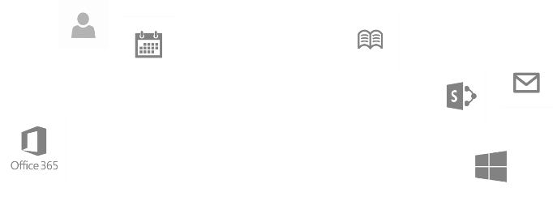
Recap
Introduction to Office 365 development
Module 1: Introduction to Office 365 development
Module 2: Getting started with Apps for Office
Module 3: Getting started with Apps for SharePoint
Module 4: Moving Full Trust Code to the Cloud Using Repeatable Patterns and Best Practices
Module 5: Getting started with the Office 365 APIs
dev.office.com/training

Slide 3
Course Agenda
Deep Dive into Integrating Office 365 APIs with Web Applications
Module 1: Deep Dive into Azure AD with the Office 365 APIs
Module 2: Deep Dive into Office 365 APIs for Calendar, Mail, and Contacts
Module 3: Deep Dive into Office 365 APIs for OneDrive for Business
Module 4: Deep Dive into Office 365 APIs for SharePoint Site services
Module 5: Deep Dive into Office 365 APIs for Yammer services
Module 6: Deep Dive into Office 365 APIs for Office Graph
Module 7: Deep Dive into Office 365 APIs for OneNote services

Slide 4
Deep Dive into Office 365 APIs for SharePoint Site services
Speaker
Speaker

Slide 5

Agenda
Overview
File Operations with SharePointClient
List Operations with REST

Slide 6
Overview

Slide 7
SharePoint Sites Services
Provides access to SharePoint online REST API
SharePointClient class simplifies programming, but limited functionality
Direct REST API calls more complex, but exposes more functionality
Notes:
The purpose of this module is to show how you can access the complete SharePoint REST API
The SharePointClient only has access to Files, but we can get an Access Token via the Discovery Service for use with REST calls.

Slide 8
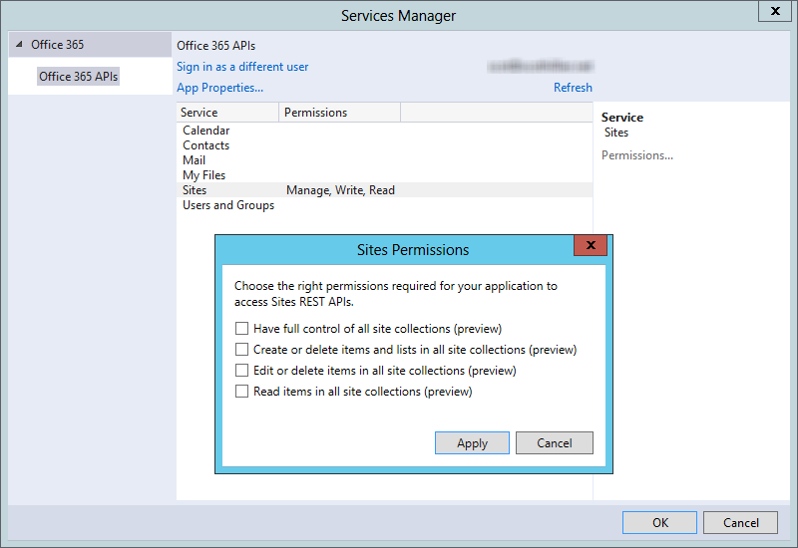
Permissions
Notes:
Just to show the various permissions that are available

Slide 9
File Operations with SharePointClient

Slide 10
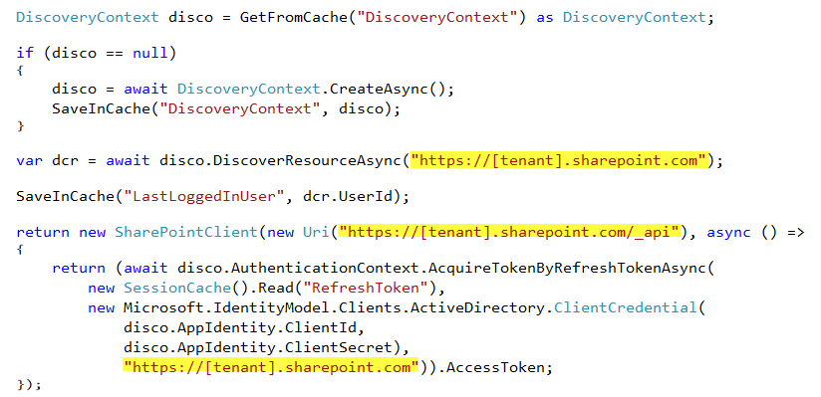
SharePointClient class
Discovery Service discovers resource
SharePointClient.Files abstracts Files API
Notes:
The discovery service discovers the SharePoint resource, which we can use to access document libraries

Slide 11

Reading File Metadata
Read Files collection
Can also read an individual Folder
Paging is accomplished post-query using LINQ
Notes:
No support for $skip and $orderby so paging is post-query

Slide 12
Uploading a new File
Use AddAsync method
Provide a file name and the file stream

Slide 13

Deleting a File
Get the target file using GetByAsync method
Delete using DeleteAsync method

Slide 14
demo
File operations with the SharePointClient

Slide 15
List Operations with REST

Slide 16
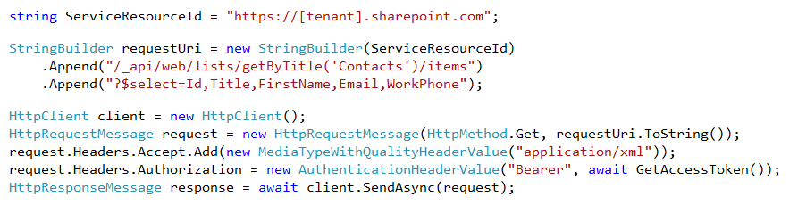
Reading List Items
Access the SharePoint REST API with the Access Token
Notes:
No support for $skip and $orderby so paging is post-query

Slide 17
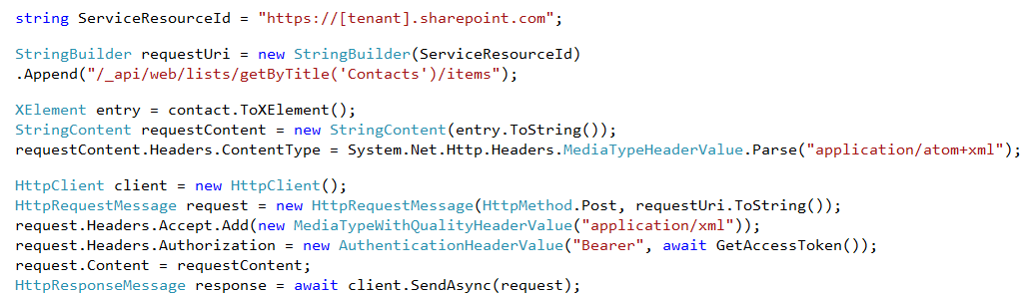
Adding a New List Item
Create XML message with list item data
POST to list items endpoint

Slide 18
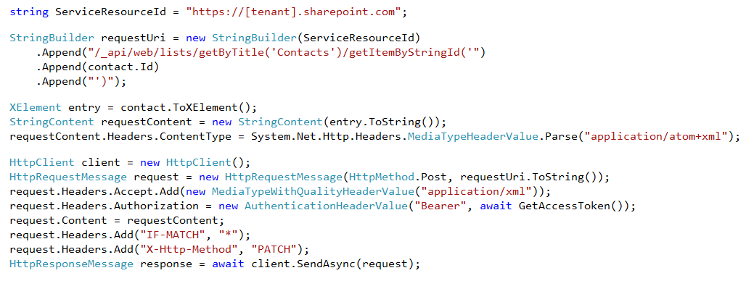
Updating a List Item
Create XML message with list item data
POST to target item ID
Notes:
Notice how the FormDigest isn’t passed
We get all the permissions we need from Azure Active Directory

Slide 19
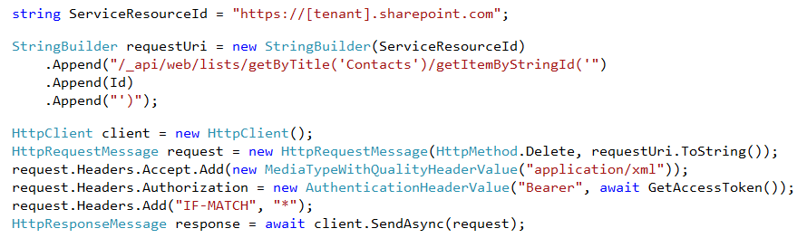
Deleting a List Item
DELETE the target item by ID
Supports the use of eTags

Slide 20
demo
File Operations with REST

Slide 21
Summary
Overview
File Operations with SharePointClient
List Operations with REST

Slide 22
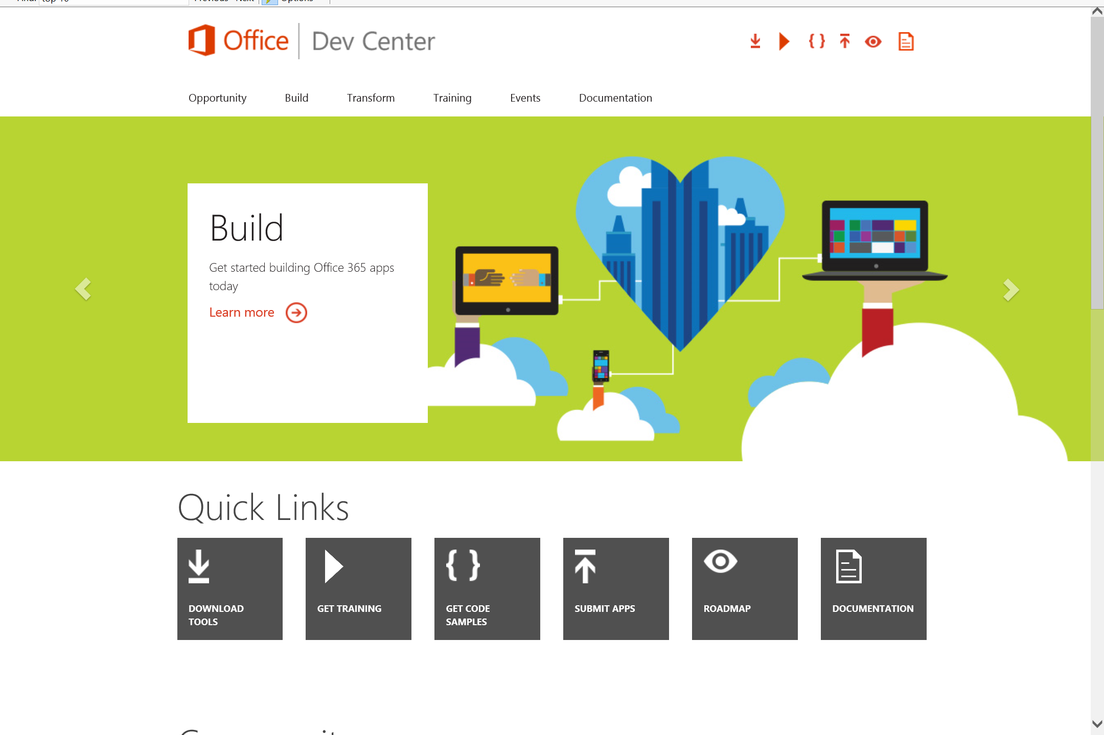
Dev.
Office
.com
One stop shop for Office Developer Platform

Slide 23
Calls to action
Explore our developer center
http://dev.office.com
Jumpstart into our training http://dev.office.com/training
Play with our code samples http://dev.office.com/code-samples
Get answers
http://aka.ms/AskSharePoint
http://aka.ms/AskOffice
Give feedback Drive our roadmap http://aka.ms/OfficeDevFeedback

Slide 24


Transform your code Providing App Model Patterns for common Full Trust Code scenarios
60+ Visual Studio projects Common scenarios
Branding
Site provisioning
Remote event receivers
Large file support
Taxonomy driven navigation
And much more…
Contribute
Open source coming soon!
Developer
Patterns & Practices
aka.ms/OfficeDevPnP

Slide 25
Microsoft Virtual Academy courses
2014
2015
Deep Dive into integrating Office 365 APIs with your mobile device development
Deep dive into the building blocks and services of the SharePoint platform
Deep Dive into integrating Office 365 APIs with your standalone web application development
Introduction to Office 365 Development
Deep Dive into the Office 365 App Model
Deep Dive into Office 365 Development on non-Microsoft Stack
Shipping your Office 365 App to the Office Store
Aug
Sept
Oct
Nov
Dec
Jan
Feb

Slide 26

© 2014 Microsoft Corporation. All rights reserved. Microsoft, Windows, and other product names are or may be registered trademarks and/or trademarks in the U.S. and/or other countries.
The information herein is for informational purposes only and represents the current view of Microsoft Corporation as of the date of this presentation. Because Microsoft must respond to changing market conditions, it should not be interpreted to be a commitment on the part of Microsoft, and Microsoft cannot guarantee the accuracy of any information provided after the date of this presentation. MICROSOFT MAKES NO WARRANTIES, EXPRESS, IMPLIED OR STATUTORY, AS TO THE INFORMATION IN THIS PRESENTATION.

